Slide 1
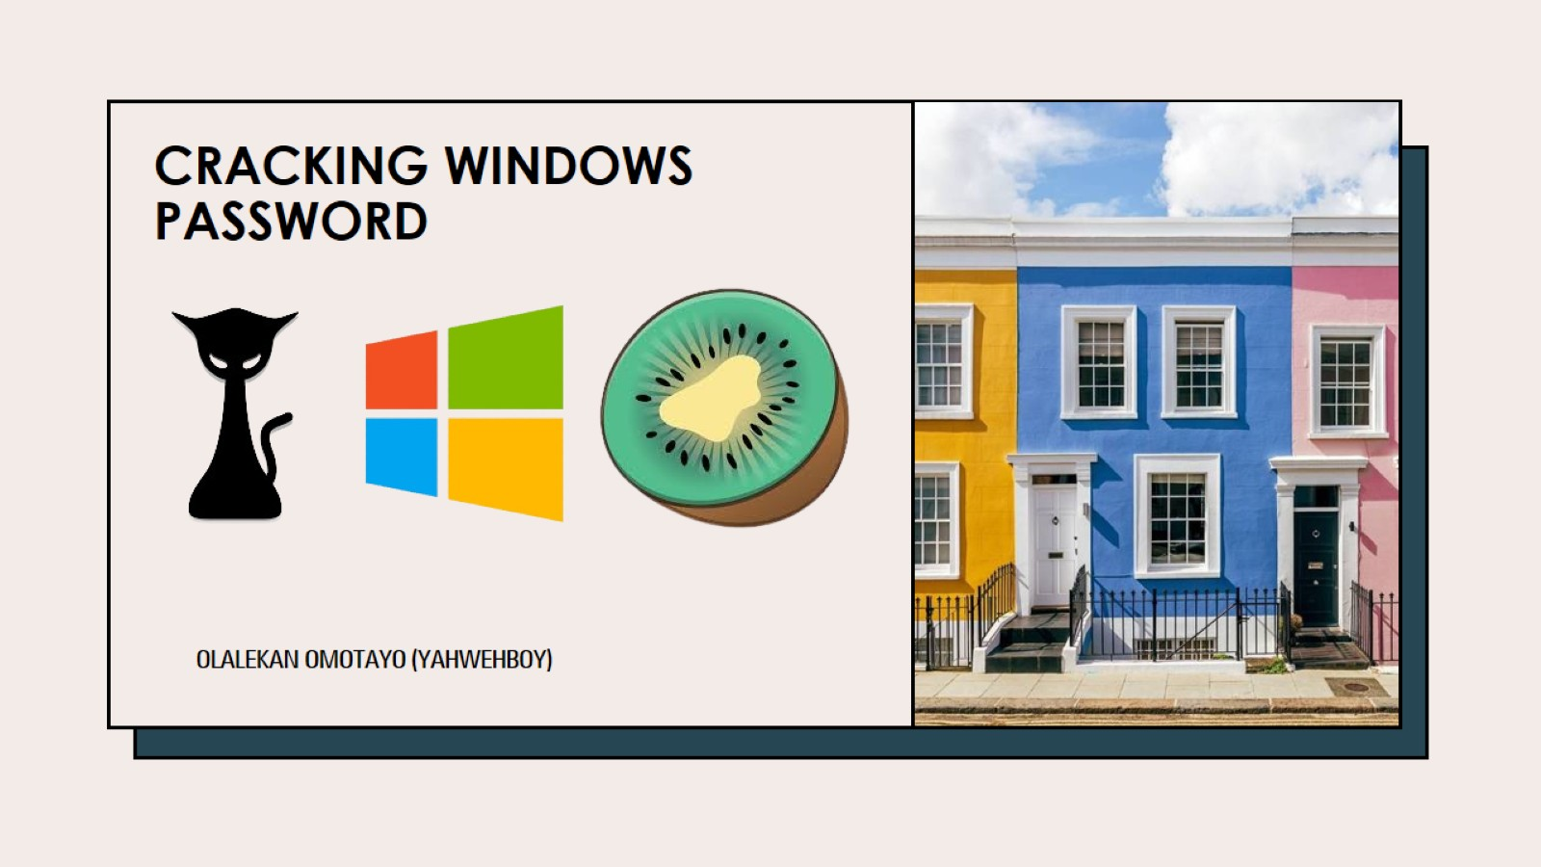
CRACKING WINDOWS PASSWORD

Slide 2
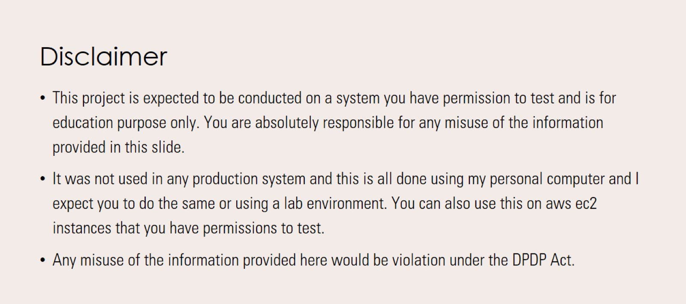
Disclaimer

Slide 3
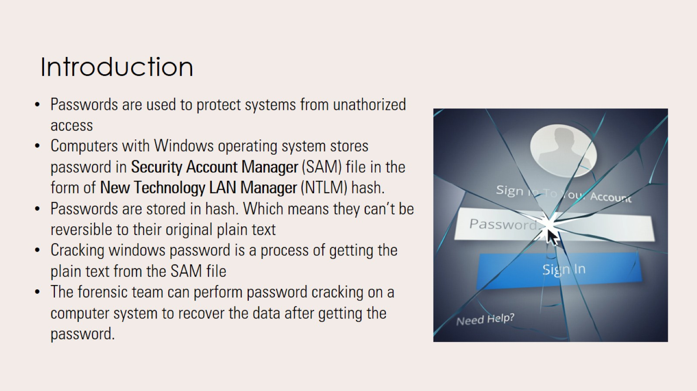
Introduction

Slide 4
Password Cracking Techniques
Brute Force: A brute force technique is an attempt to crack passwords using permutation and combination approach. This method takes a lot of time and memory consumption depending on the length and complexity of password.
Dictionary: A dictionary technique is an attempt to store in-build passwords in a file known as dictionary. Instead of trying all combination of passwords, it creates a word-list of most common passwords and calculates the hash values while cracking the passwords. It will only able to crack the password if it is stored in dictionary file. This technique takes less time as compared to brute-force technique to crack the password.
Rainbow Tables: This technique is same as dictionary, but instead of calculating hash vales during password cracking; it stores the in-built hash values of password in the tables. Thus, this technique takes less time as compared to brute-force and dictionary technique to crack the password.

Slide 5

Mimikatz
Mimikatz was first developed in 2007 by Benjamin Delpy. It is an open-source application and post exploitation Windows operating system tool that allows users to view authentication credentials.
This tool provides hashes from SAM file of Windows operating system to users.
Windows store password data in an NTLM hash. The forensics team can use Mimikatz tool to get the hash string and use hashcat tool to get plain text and pass it to the target computer to login.

Slide 6
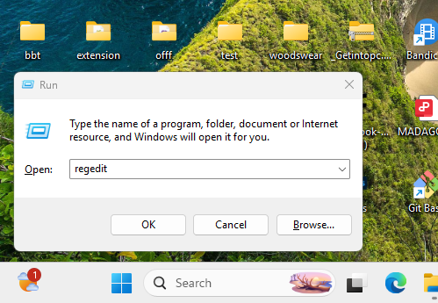
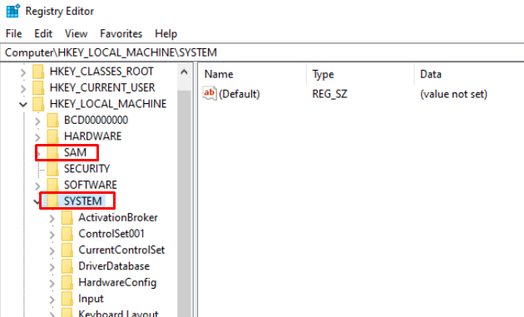
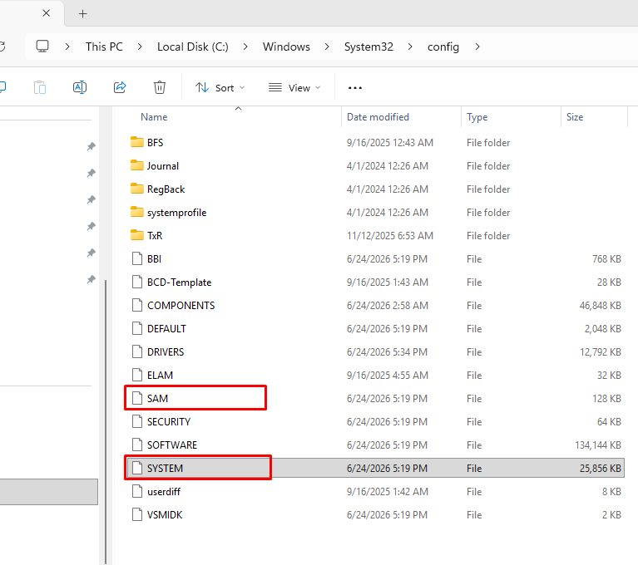
Getting Password Hash using Mimikatz
Step 1: Open Run box by clicking “Window + R” on keyboard and type “regedit” as shown in the screenshot, respectively. Click “OK” to proceed.
Step 2: A Registry Editor file with SAM and SYSTEM folder will open as shown. The SAM and SYSTEM files are in “C:\Windows\System32\config”.

Slide 7
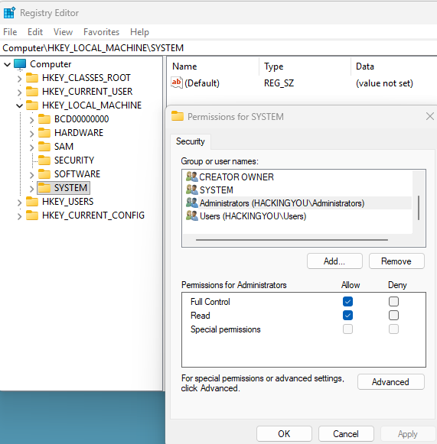
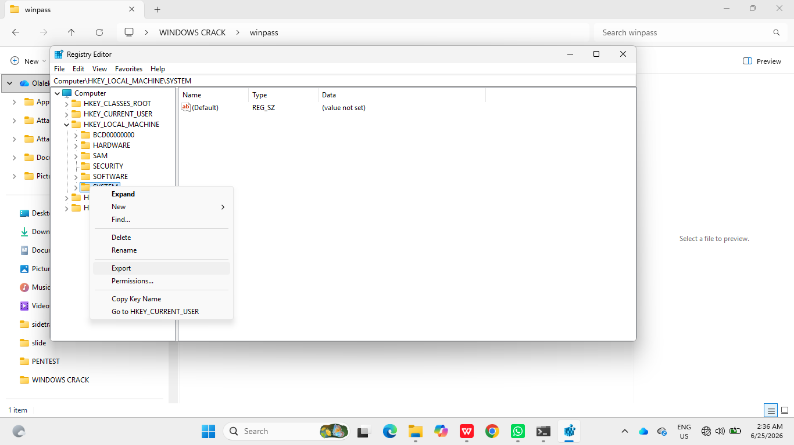
Getting Password Hash using Mimikatz Cont’d
Step 3: These SAM and SYSTEM files can be accessed by registry editor after giving administrative permissions. Right click on the SAM file as shown below. Then allow “Full Control” and “Read” by clicking the check box. Do the same for SYSTEM.
Step 4: Export the SAM file after giving the administrative permissions. Right click on the SAM file and click “Export”. Save the file by giving file name as “SAM” and type as “Registry Hive Files” as shown below.

Slide 8
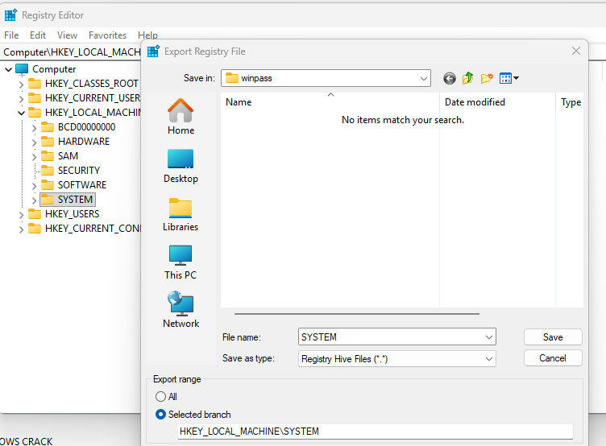
Getting Password Hash using Mimikatz Cont’d
Step 5: Save both SAM and SYSTEM file as “Registry Hive Files” as seen in the screenshot, on your desktop.
Step 6: Export the SYSTEM file after giving the administrative permissions. Right click on the SYSTEM file and click “Export”. Save the file by giving file name as “SYSTEM” and type as “Registry Hive Files” as shown below.

Slide 9

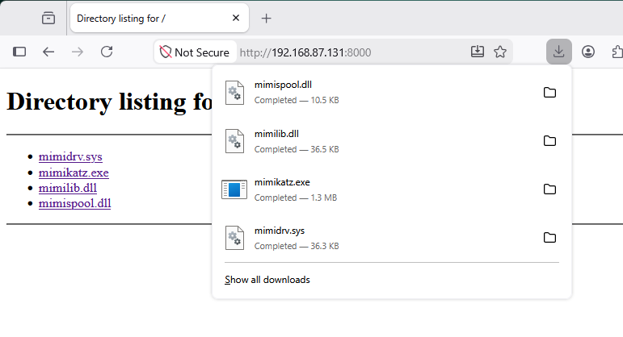
Getting Password Hash using Mimikatz Cont’d
Step 7: Mimikatz is preinstalled on Kali Linux 2026 in the following director: “/usr/share/windows-resources/mimikatz” so I started a python http server to downloads the mimikatz files as shown in the screen shots
Step 8: Download the files from kali to your windows machine in the same directory where you stored both SAM and SYSTEM files.

Slide 10
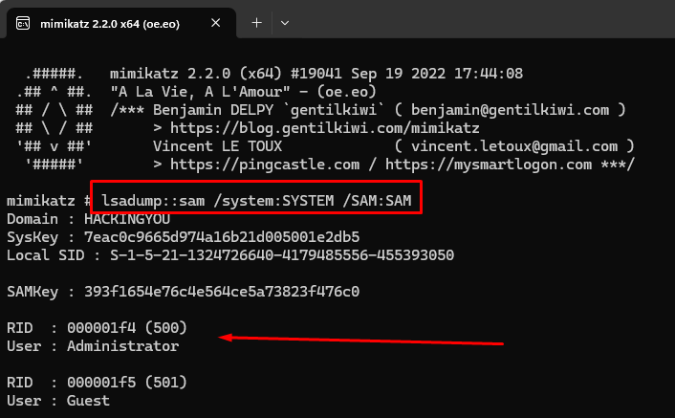
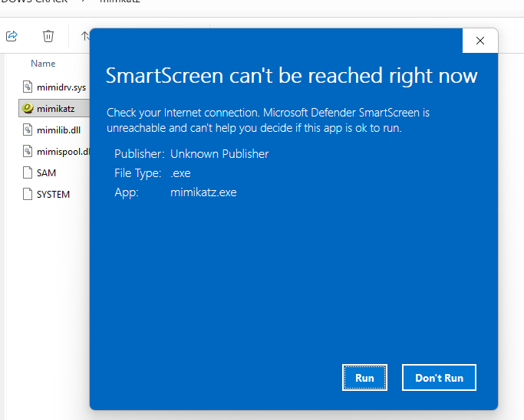
Getting Password Hash using Mimikatz Cont’d
Step 9: After downloading the files double click on the mimikatz.exe file. Click “Run” when you get a SmartScreen notification.
Step 10: A command line prompt of Mimikatz tool will open as shown

Slide 11
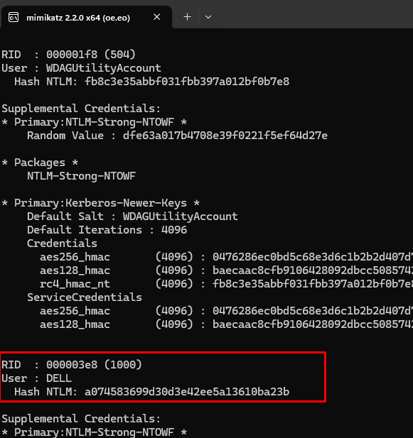
Getting Password Hash using Mimikatz Cont’d
Step 11: Type “lsadump::sam /system: SYSTEM /SAM:SAM” command in command line prompt of Mimikatz tool. Press Enter. The command will show NTLM hash password of Windows operating system as shown.

Slide 12

Hashcat
Hashcat is an advanced password recovery tool. It had a proprietary code base until 2015, but now it is an open-source tool and available in Kali Linux operating system.
It recovers and provides plaintext of various hash such as LM, NTLM, MD5, SHA, and so on.

Slide 13

Recovering Plaintext from NTLM Hash With Hashcat
The Mimikatz tool provides NTLM hash of Windows operating system password. The password in plaintext from NTLM hash can be recovered with hashcat tool with following steps:It recovers and provides plaintext of various hash such as LM, NTLM, MD5, SHA, and so on.

Slide 14
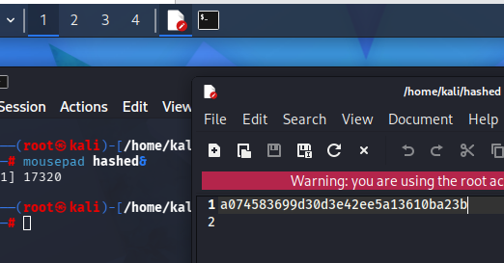
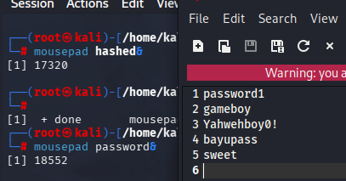
Recovering Plaintext from NTLM Hash With Hashcat Cont’d
Step 1: Open Kali Linux operating system and copy the NTLM hash you recovered from mimikatz previously and paste in a text file. You can use mousepad or any text editor then save the file name as “hashed” as seen in the screenshot.
Step 2: Instead of looking for random password file online I compiled my own password based on the information I have gathered about the target this is how real attackers would do. And saved the passwords in a file named password as seen in the following screenshot.

Slide 15
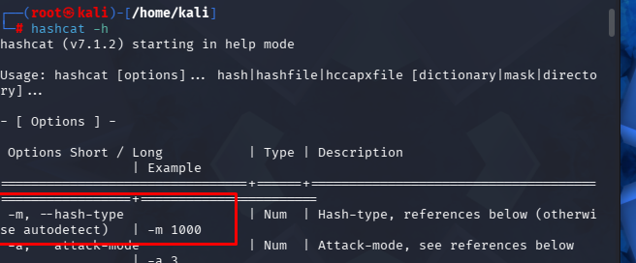
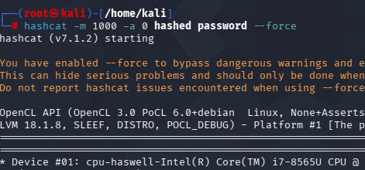
Recovering Plaintext from NTLM Hash With Hashcat Cont’d
Step 3: Open the terminal and type “hashcat –h” to see instructions on how to use the hashcat tool. The hash mode for NTLM hash is 1000 and the attack mode is 0 which means straight according hashcat config.
Step 4: To crack the password, make sure that both password and hash file are in the same directory, then type the command “hashcat –m 1000 –a 0 hashed password –force”. In this command, -m stands for hash mode (e.g., 1000 stands for NTLM hash, and -a stands for attack mode

Slide 16

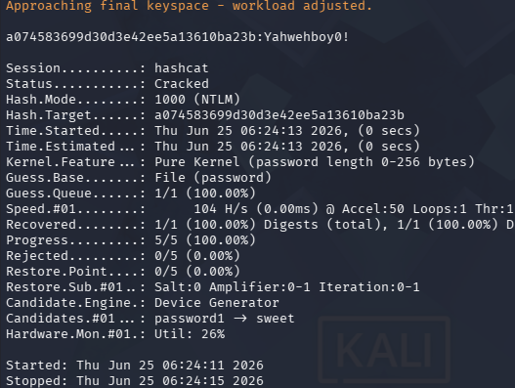
Recovering Plaintext from NTLM Hash With Hashcat Cont’d
Step 5: We successfully cracked the password. The plaintext of the NTLM hash is displayed and highlighted in red rectangular box. The plaintext of the NTLM hash is “Yahwehboy0!”. Type the command to get the cracked password “hashcat –m 1000 –a 0 hashed password –force --show”

Slide 17
Countermeasures
Strong Password: Establish strong password using special characters, numbers, and lower- and upper-case alphabets.
Minimum Password Length: The length of the password should be set to at least 14 characters. The long passwords are harder to crack than the short ones.
Dictionary words: Do not use dictionary words such as password, qwerty, abc123, etc. These passwords can be cracked easily with tools. Do not rely on similar looking characters such as 3 → E , 5 →S , ! → 1. These words are also stored in dictionary.
Minimum Password Age: The users must change the password after some time (30 days). This will reduce the risk of password cracking.
Stronger Authentication Method: Use stronger authentication methods such as enable Gmail one time password feature to login in a new device.

Slide 18
Countermeasures Cont’d
Different Password: Use different passwords for different device or websites.
Sharing Password:Do not share passwords with anyone or change password immediately after usage, if shared.
Personal Information: Do not use personal information such as date of birth, pet names, vehicle number, etc. An attacker can easily guess the password by knowing personal details through social engineering.
Storing Password: Avoid storing passwords in an unsecured location such as desktop or mobile phones. An attacker can access those passwords by hacking the device. Try to remember the passwords. And consider using password manager.

